Slide 1

KaaShivInfoTech
Presents
Intel XDK
For Inplant Training / Internship, please download the "Inplant training registration form" from our website www.kaashivinfotech.com. Fill the form and send it to kaashiv.info@gmail.com

Slide 2
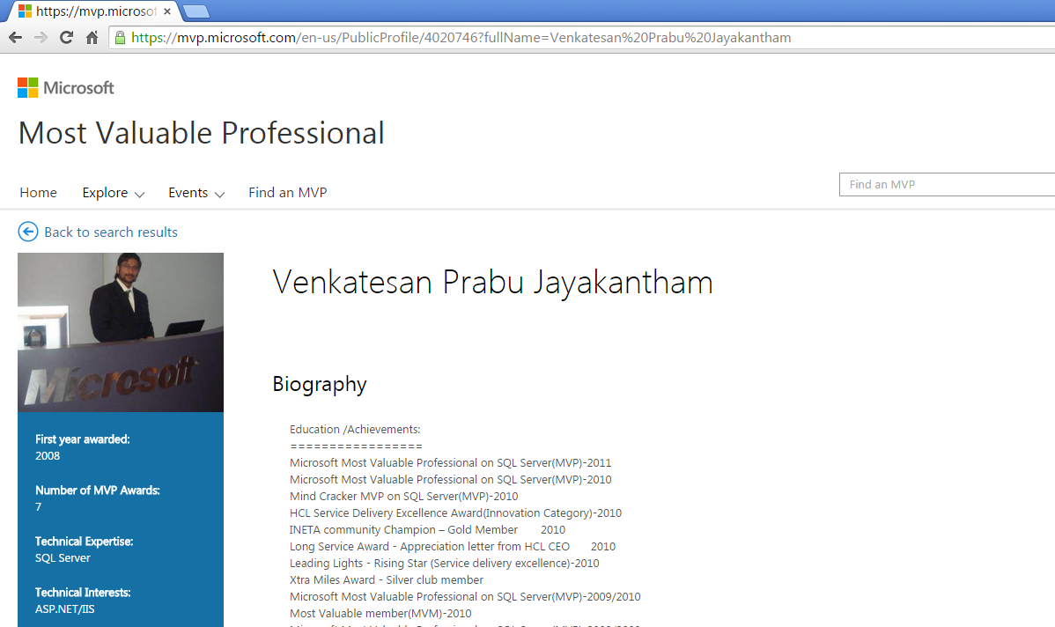
www.Kaashivinfotech.com

Slide 3




Intel® XDK for IoT – Integration Point #1
Develop companion HTML5 apps to interface to IoT devices.
Physical I/O:
GPIO, ADC, I²C, SPI, etc.
Gateway
Name server
Analytics
Etc.
HTML5/Javascript
RTOS
plugin
Linux
Application*
Cordova
*Aplication can be written using any supported languag on device.
For Inplant Training / Internship, please download the "Inplant training registration form" from our website www.kaashivinfotech.com. Fill the form and send it to kaashiv.info@gmail.com
3

Slide 4
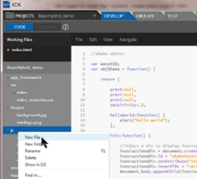





Intel® XDK for IoT – Integration Point #2
Physical I/O:
GPIO, ADC, I²C, SPI, etc.
Intel XDK
RTOS
Edit Node.js app
Send app to device
Run app remotely
Remote debug
Linux
Node.js Application
IoT Device
For Inplant Training / Internship, please download the "Inplant training registration form" from our website www.kaashivinfotech.com. Fill the form and send it to kaashiv.info@gmail.com
4
4

Slide 5
Intel® XDK IoT Device Daemon Overview
Node.js App
V8 Debug Protocol
appDaemon Protocol
run, stop, restart, install, debug, sync
Debug Protocol Translator
IoT Device
Chrome Debug Protocol (ws)
WebSocket (ws)
Chrome Debug Protocol (ws)
Websocket (ws)
Intel® XDK
Dev Machine Running XDK
For Inplant Training / Internship, please download the "Inplant training registration form" from our website www.kaashivinfotech.com. Fill the form and send it to kaashiv.info@gmail.com

Slide 6
JavaScript I/O Libraries (for Galileo)
mraa – open source library for Galileo/Edison used API similar to the MBED api (Intel Developer Relations [DRD])
io-js- open source library for Galileo/Edison used API similar to the Arduino API (Intel Labs China [ILC])
johnny-five – Open source I/O library with plugins for various boards including Galileo (Gen2 support in the works)
on/off – open source i/o library that can be used to manipulate ‘raw’ GPIO/PWM via sysfs interface
i2c – node.js i2c library (uses sysfs)
+More: Lots of node.js modules for various hardware, etc.
For Inplant Training / Internship, please download the "Inplant training registration form" from our website www.kaashivinfotech.com. Fill the form and send it to kaashiv.info@gmail.com

Slide 7
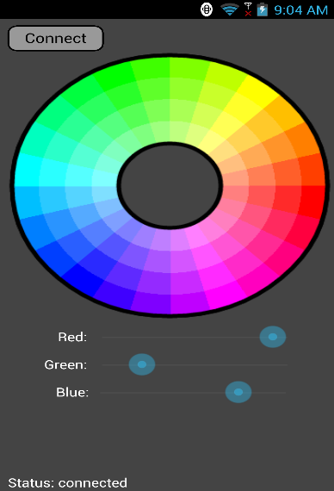
DEMO
RGB Lighting DEMO
IoT Device (Galileo):
- Pwm Led Controller on i2c bus
- RGB Led
- Node.js w/ Socket.io server
HTML5 App (Lenovo K900):
Socket.io connection to IoT device
Change lighting color
Cordova App
Both made with Intel XDK!
For Inplant Training / Internship, please download the "Inplant training registration form" from our website www.kaashivinfotech.com. Fill the form and send it to kaashiv.info@gmail.com

Slide 8




Contact Number
Venkat - 766 766 2428
Email – kaashiv.info@gmail.com
Priyanka - 72994 88034

Slide 9

Thank you
For Inplant Training / Internship, please download the "Inplant training registration form" from our website www.kaashivinfotech.com. Fill the form and send it to kaashiv.info@gmail.com
www.kaashivinfotech.com

