Slide 1

KaaShiv InfoTech
presents
Intel XDK
For Inplant Training / Internship, please download the "Inplant training registration form" from our website www.kaashivinfotech.com. Fill the form and send it to kaashiv.info@gmail.com
www.kaashivinfotech.com

Slide 2
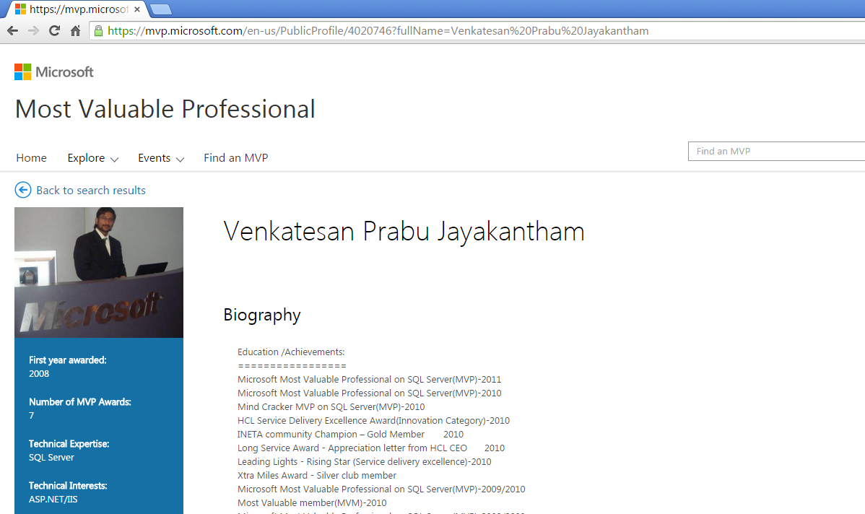
www.kaashivinfotech.com

Slide 3


Intel® HTML5 Tools for developing mobile applications
HTML5 is the new HTML standard. Recently, Intel Corporation announced a set of HTML5 Tools for developing mobile applications. This paper shows you how to port an Apple iOS* accelerometer app to HTML5 using these tools.
Please note: Auto-generated code created by the XDK may contain code licensed under one or more of the licenses detailed in Appendix A of this document.
Please refer to the XDK output for details on which libraries are used to enable your application.
For Inplant Training / Internship, please download the "Inplant training registration form" from our website www.kaashivinfotech.com. Fill the form and send it to kaashiv.info@gmail.com

Slide 4
Intel® HTML5 App Porter Tool
The first thing we’ll do is take an iOS accelerometer app and convert the Objective-C*source code to HTML5. We’ll do this using the Intel® HTML5 App Porter Tool and the source code found here.
[iOS_source.zip] (Note: IOS_source sample code is provided under the Intel Sample Software License detailed in Appendix B). You can download the Intel HTML5 App Porter Tool from the Tools tab here: http://software.intel.com/en-us/html5
After filling in and submitting the form with your e-mail address, you will get links for downloading this tool. The instructions for how to use this tool can be found on this site http://software.intel.com/en-us/articles/tutorial-creating-an-html5-app-from-a-native-ios-projectwith-intel-html5-app-porter-tool.
For Inplant Training / Internship, please download the "Inplant training registration form" from our website www.kaashivinfotech.com. Fill the form and send it to kaashiv.info@gmail.com

Slide 5
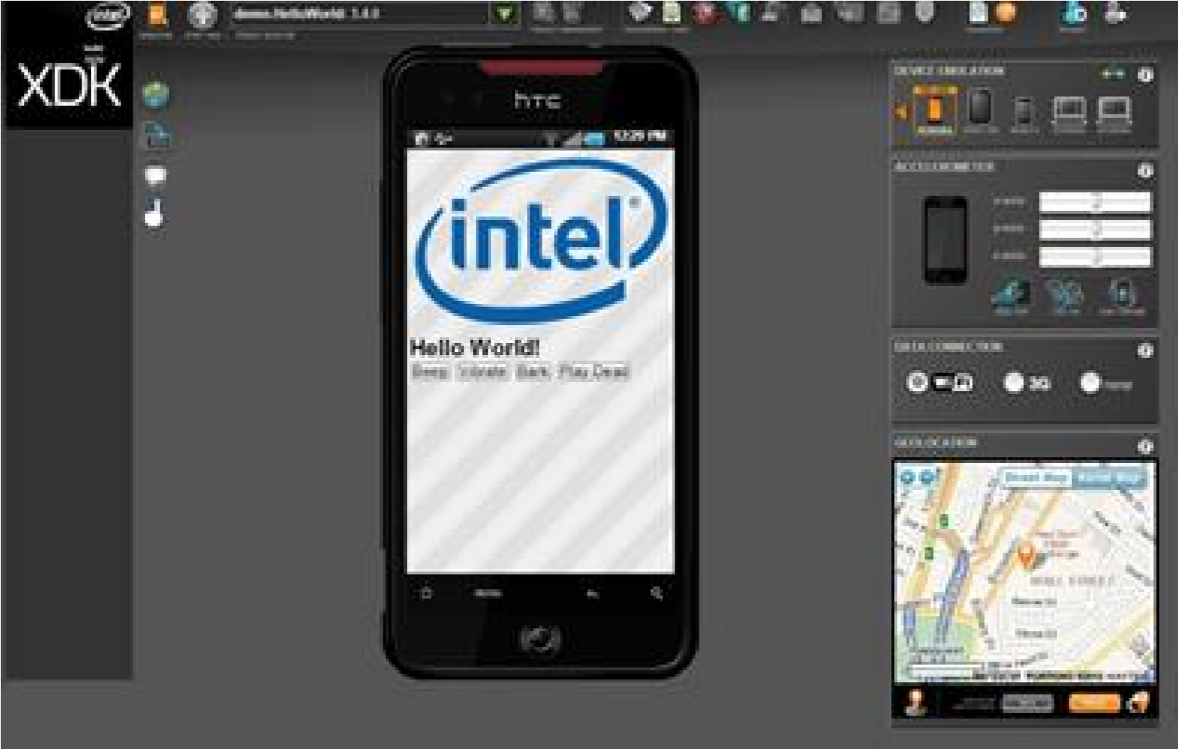
Intel® XDK
You can open the HTML5 code in any IDE. Intel offers you a convenient tool for developing HTML5 applications.
Intel® XDK – Cross platform development kit (http://html5dev-software.intel.com/). With Intel XDK, developers can write a single source code for deployment on many devices.
For Inplant Training / Internship, please download the "Inplant training registration form" from our website www.kaashivinfotech.com. Fill the form and send it to kaashiv.info@gmail.com

Slide 6
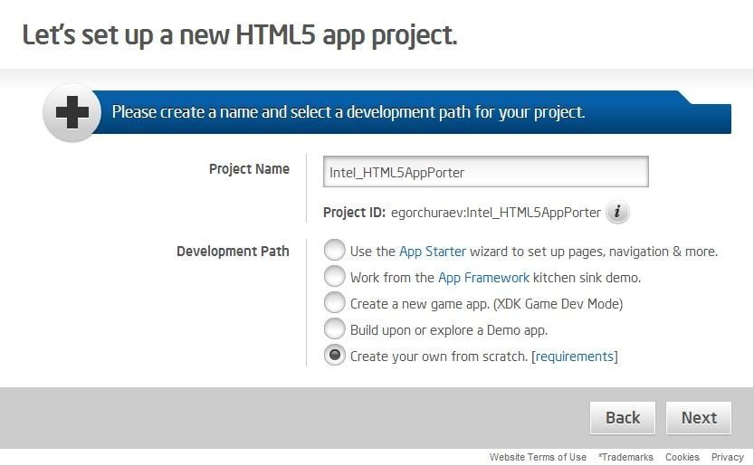
If you’re creating a new project, enter the Project Name and check “Create your own from scratch,” as shown in the screen shot below.
For Inplant Training / Internship, please download the "Inplant training registration form" from our website www.kaashivinfotech.com. Fill the form and send it to kaashiv.info@gmail.com

Slide 7
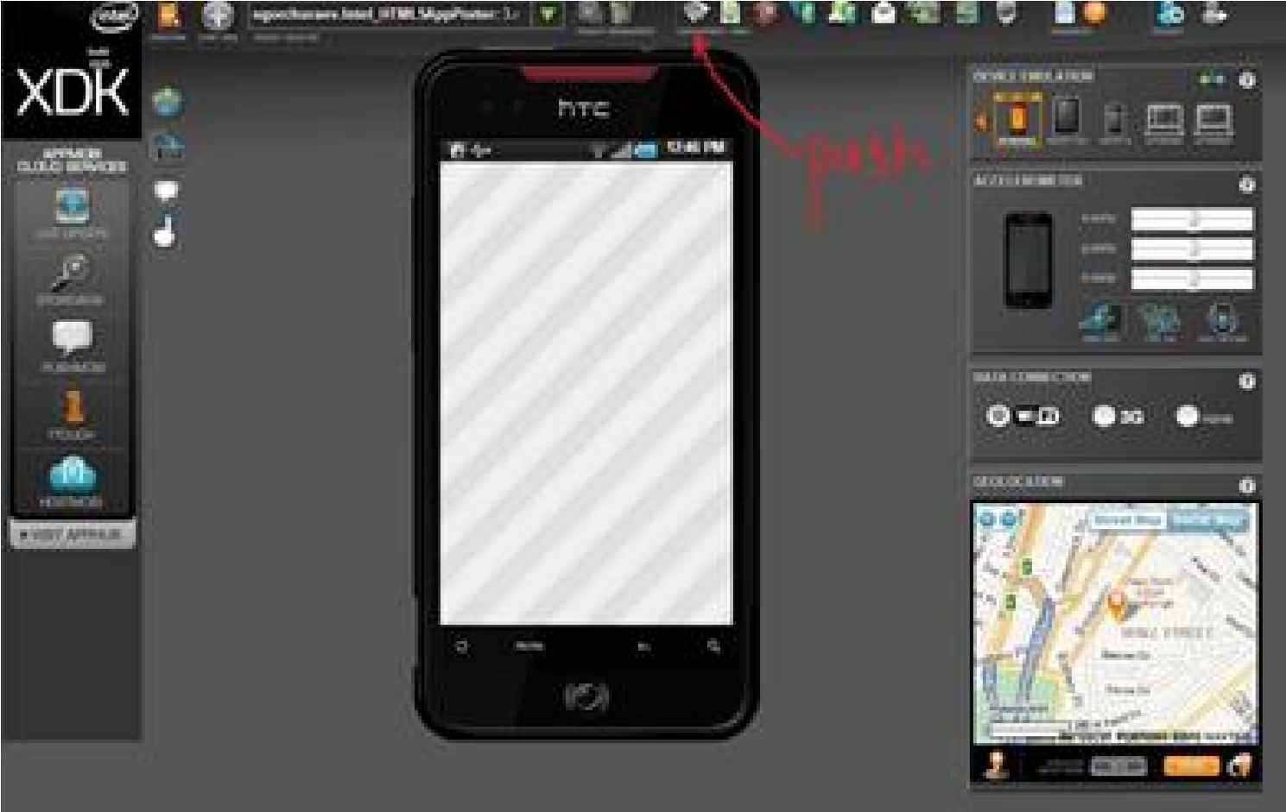
Check “Use a blank project.” Wait a bit, and you will see the message “Application Created Successfully!”
Click “Open project folder.”
For Inplant Training / Internship, please download the "Inplant training registration form" from our website www.kaashivinfotech.com. Fill the form and send it to kaashiv.info@gmail.com

Slide 8
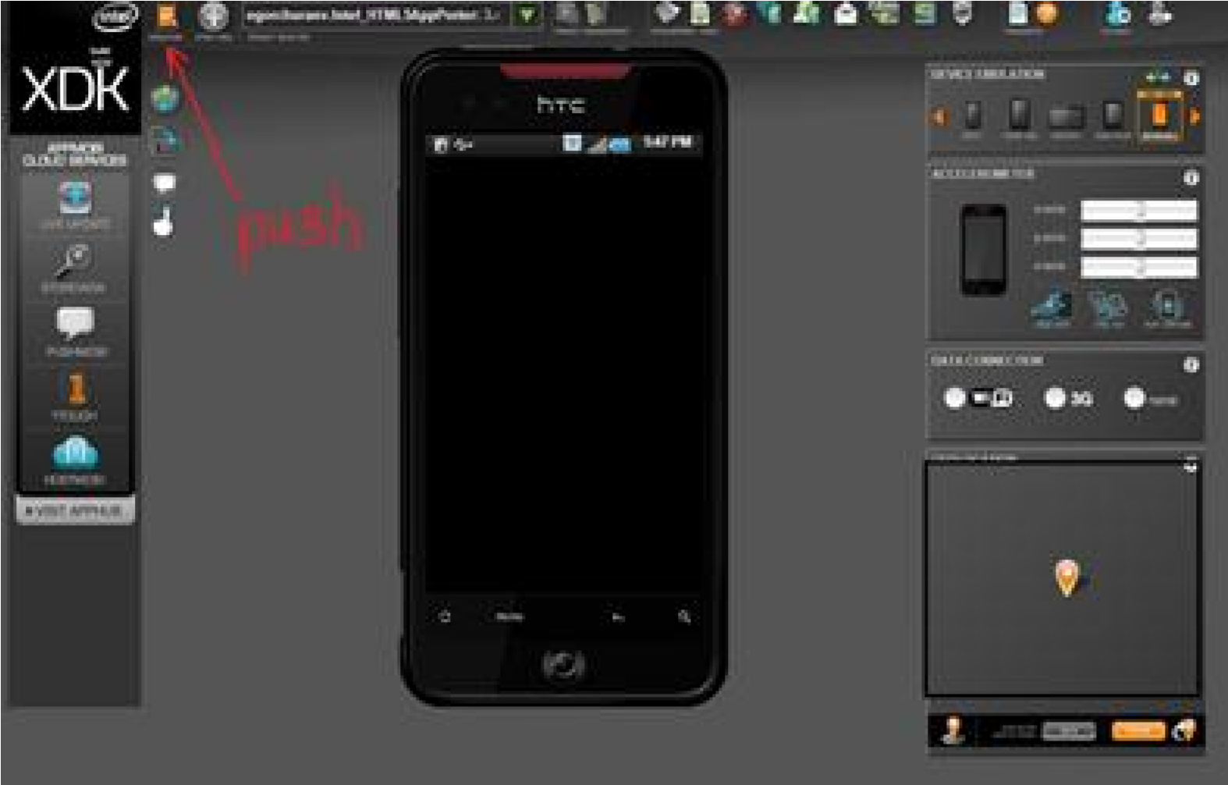
Remove all files from this folder and copy the ported files. We haven’t quite ported the accelerometer app yet. We still have to write an interface for it. It is possible to remove the hooks created by the Intel HTML5 App Porter tool. Remove these files:
todo_api_application__uiaccelerometerdelegate.js
todo_api_application_uiacceleration.js
todo_api_application_uiaccelerometer.js
todo_api_js_c_global.js
To update the project in Intel XDK, go to the editor window in the Windows emulator.
Open the index.html file and remove the lines left from the included files.
For Inplant Training / Internship, please download the "Inplant training registration form" from our website www.kaashivinfotech.com. Fill the form and send it to kaashiv.info@gmail.com

Slide 9
Open the todo_api_application_appdelegate.js file and implement the unmapped “window” property of the delegate.
application.AppDelegate.prototype.setWindow = function(arg1) {
// ================================================================ // REFERENCES TO THIS FUNCTION:
// line(17): C:\Work\Blogging\echuraev\Accelerometer\Accelerometer\AppDelegate.m
// In scope: AppDelegate.application_didFinishLaunchingWithOptions
// Actual arguments types: [*js.APT.View]
// Expected return type: [unknown type]
//
//if (APT.Global.THROW_IF_NOT_IMPLEMENTED)
//{
// TODO remove exception handling when implementing this method
// throw "Not implemented function: application.AppDelegate.setWindow";
//}
this._window = arg1;
};
application.AppDelegate.prototype.window = function() {
// ================================================================ // REFERENCES TO THIS FUNCTION:
// line(20): C:\Work\Blogging\echuraev\Accelerometer\Accelerometer\AppDelegate.m
// In scope: AppDelegate.application_didFinishLaunchingWithOptions
For Inplant Training / Internship, please download the "Inplant training registration form" from our website www.kaashivinfotech.com. Fill the form and send it to kaashiv.info@gmail.com

Slide 10
// Actual arguments types: none
// Expected return type: [unknown type]
//
// line(21): C:\Work\Blogging\echuraev\Accelerometer\Accelerometer\AppDelegate.m
// In scope: AppDelegate.application_didFinishLaunchingWithOptions
// Actual arguments types: none
// Expected return type: [unknown type]
//
//if (APT.Global.THROW_IF_NOT_IMPLEMENTED)
//{
// TODO remove exception handling when implementing this method
// throw "Not implemented function: application.AppDelegate.window";
//}
return this._window;
};
Open the viewcontroller.js file. Remove all the functions used for working with the accelerometer in the old iOS app. In the end we get this file:
APT.createNamespace("application");
document.addEventListener("appMobi.device.ready",onDeviceReady,false);
APT.ViewController = Class.$define("APT.ViewController");
application.ViewController = Class.$define("application.ViewController", APT.ViewController, {
__init__: function() { this.$super();
},
});

Slide 11
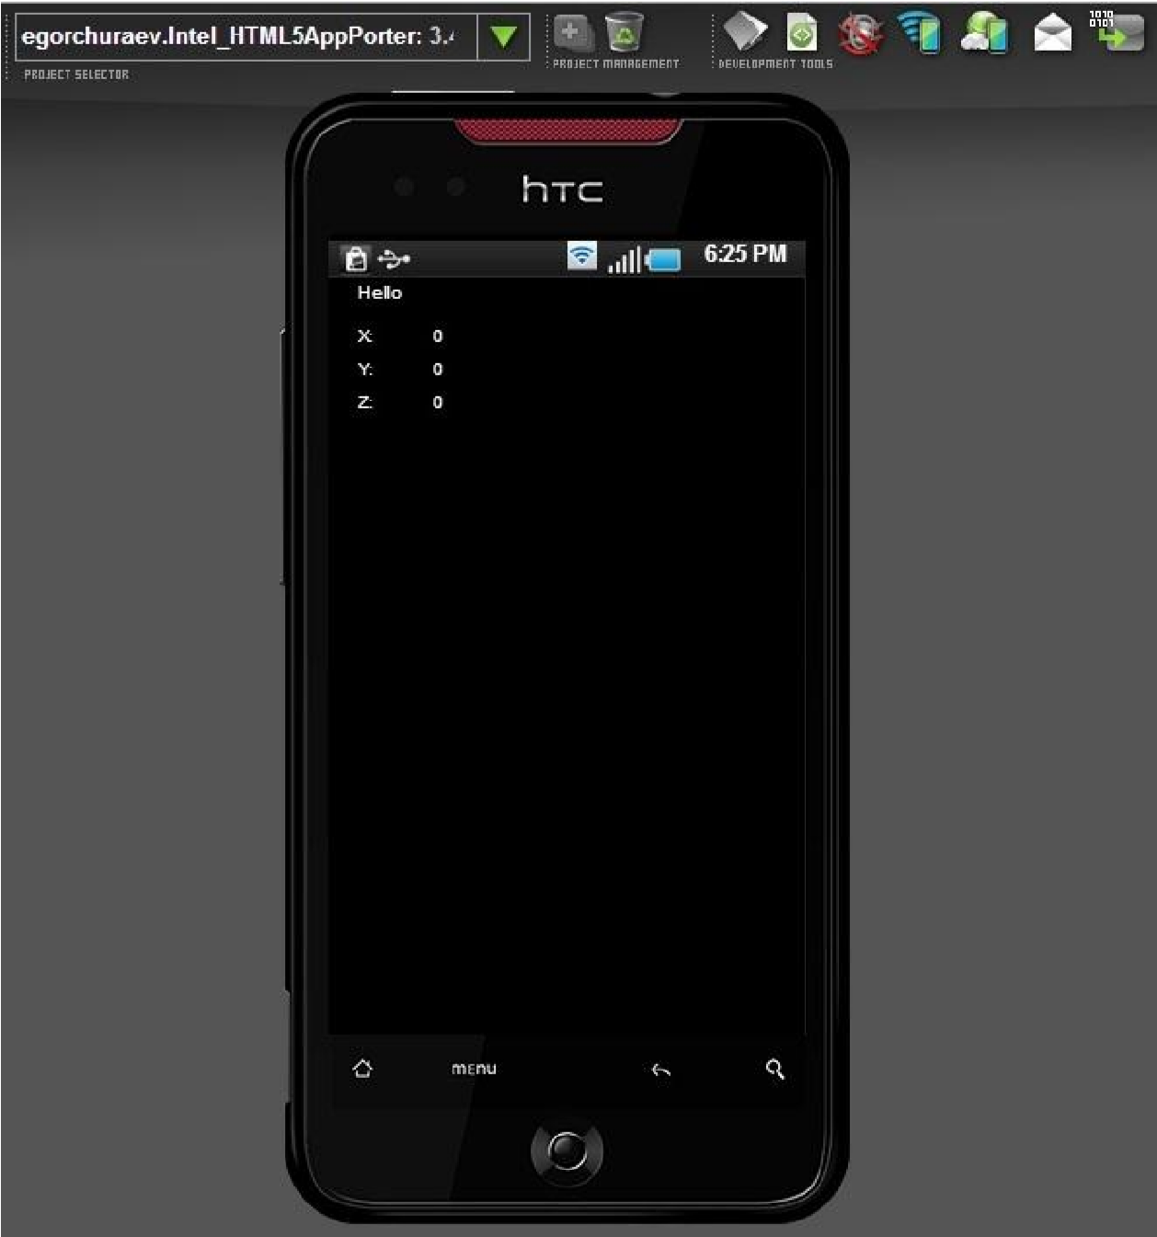
For Inplant Training / Internship, please download the "Inplant training registration form" from our website www.kaashivinfotech.com. Fill the form and send it to kaashiv.info@gmail.com

Slide 12
To code the accelerometer functions, we need to use the appMobi JavaScript Library. Documentation for this library can be found here. It’s installed when you download Intel XDK.
Open the index.html file and add this line into the list of scripts:
<script type="text/javascript" charset="utf-8" src="http://localhost:58888/_appMobi/appmobi.js"></script>
Open the ViewController_View_774585933.html file. We have to rename fields to more logical names from:
<div data-apt-class="Label" id="Label_705687206">0</div>
<div data-apt-class="Label" id="Label_782673145">0</div> <div data-apt-class="Label" id="Label_1067317462">0</div> to:
<div data-apt-class="Label" id="accel_x">0</div>
<div data-apt-class="Label" id="accel_y">0</div>
<div data-apt-class="Label" id="accel_z">0</div>
The same should be done in the ViewController_View_774585933.css file, where we have to rename the style names.
Open the viewcontroller.js file and write some functions for using the accelerometer.
function suc(a) { document.getElementById('accel_x').innerHTML = a.x;
For Inplant Training / Internship, please download the "Inplant training registration form" from our website www.kaashivinfotech.com. Fill the form and send it to kaashiv.info@gmail.com

Slide 13
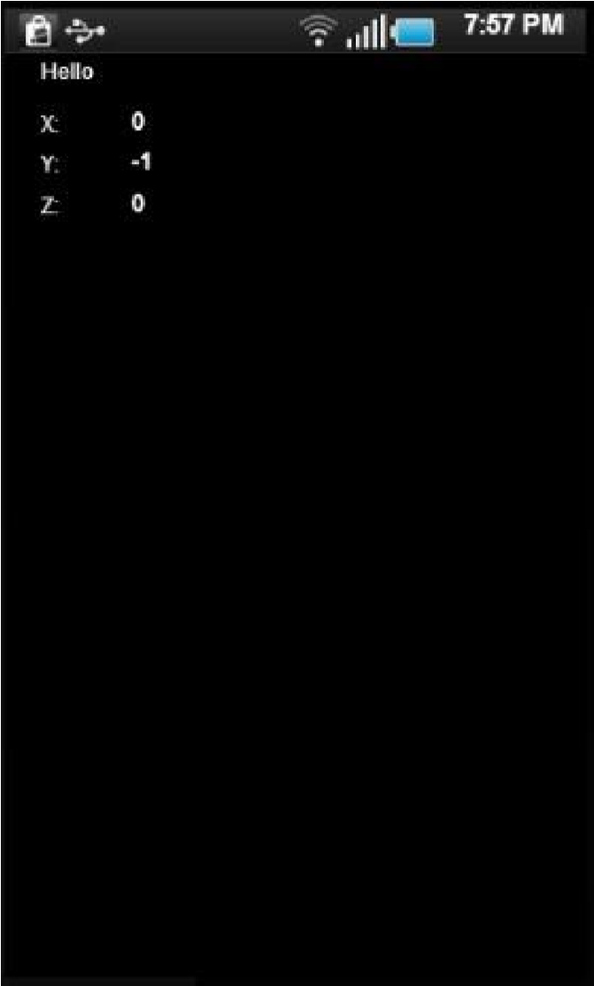
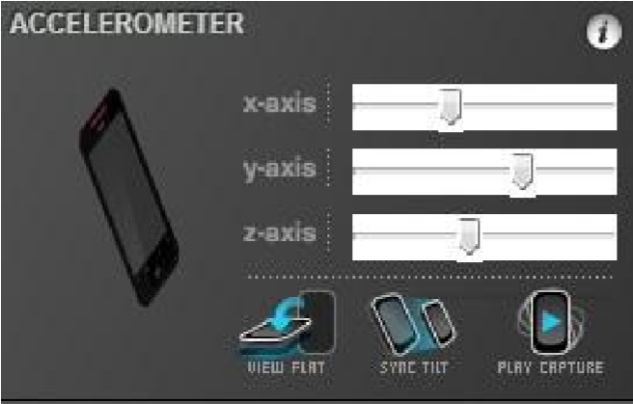
You can see how the accelerometer works on Intel XDK using the “ACCELEROMETER” panel:
For Inplant Training / Internship, please download the "Inplant training registration form" from our website www.kaashivinfotech.com. Fill the form and send it to kaashiv.info@gmail.com

Slide 14
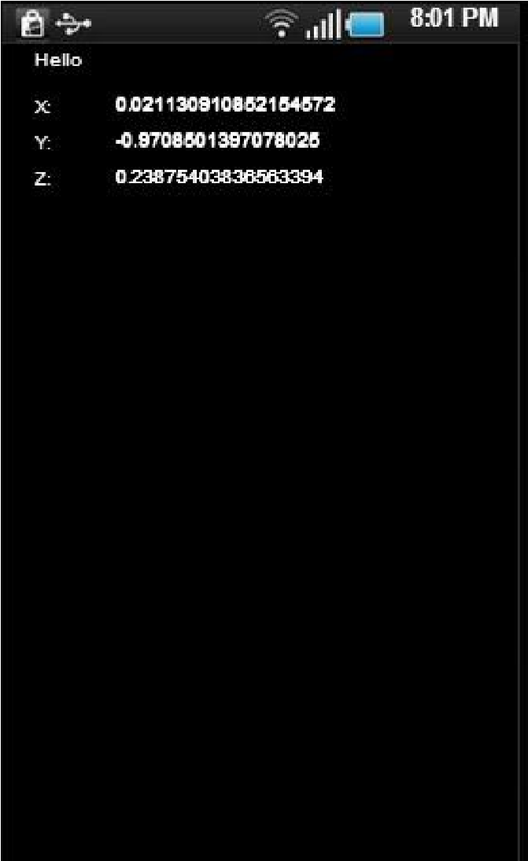
The complete application source code can be found here [Result.zip].
For Inplant Training / Internship, please download the "Inplant training registration form" from our website www.kaashivinfotech.com. Fill the form and send it to kaashiv.info@gmail.com

Slide 15




Contact Number
Venkat - 766 766 2428
Email – kaashiv.info@gmail.com
Priyanka - 72994 88034
www.kaashivinfotech.com

Slide 16
Thank you
For Inplant Training / Internship, please download the "Inplant training registration form" from our website www.kaashivinfotech.com. Fill the form and send it to kaashiv.info@gmail.com

