Slide 1

KaaShiv InfoTech
presents
Intel XDK
For Inplant Training / Internship, please download the "Inplant training registration form" from our website www.kaashivinfotech.com. Fill the form and send it to kaashiv.info@gmail.com
www.kaashivinfotech.com

Slide 2
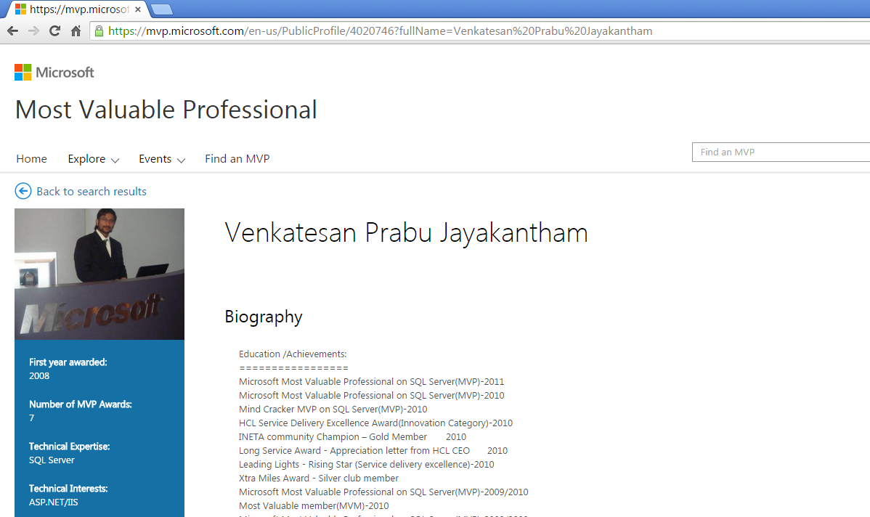

Slide 3




Intel®
XDK
HTML5 CROSS
-
PLATFORM
DEVELOPMENT
TOOLS
FOR
WEB AND HYBRID APPS
Product Brief
Intel® XDK simplified workflow enables developers to easily design, debug, build, and deploy HTML5 web and hybrid apps across multiple platforms, app stores, and form factors. Intel® XDK integrated design equips developers with the tools, standards, and technology to reach more platforms, device coverage, and app stores, while reducing time, efforts, and cost.
For Inplant Training / Internship, please download the "Inplant training registration form" from our website www.kaashivinfotech.com. Fill the form and send it to kaashiv.info@gmail.com

Slide 4
Key Benefits:
Write Once, Run Anywhere
One HTML5 programming language enables HTML5 cross-platform apps for multiple app stores and form factor devices helps broaden market reach and increase revenue opportunities.
Faster Time –to-Market through an Integrated Environment
Integrated HTML5 App Development Tools in one streamlined workflow, tested, and delivered together helps speed app development, increase productivity, and reduce costs.
Short Learning Curve through a simplified workflow
For Inplant Training / Internship, please download the "Inplant training registration form" from our website www.kaashivinfotech.com. Fill the form and send it to kaashiv.info@gmail.com

Slide 5
Intuitive app development with an easy-to-use HTML5 programming language, streamlined workflow, and quick start templates.
Amazing App Experience through tool technology
Optimized JavaScript UI framework libraries, emulation tools, and performance profiling tools provide engaging and responsive HTML5 app experiences across many form factor devices.
For Inplant Training / Internship, please download the "Inplant training registration form" from our website www.kaashivinfotech.com. Fill the form and send it to kaashiv.info@gmail.com

Slide 6
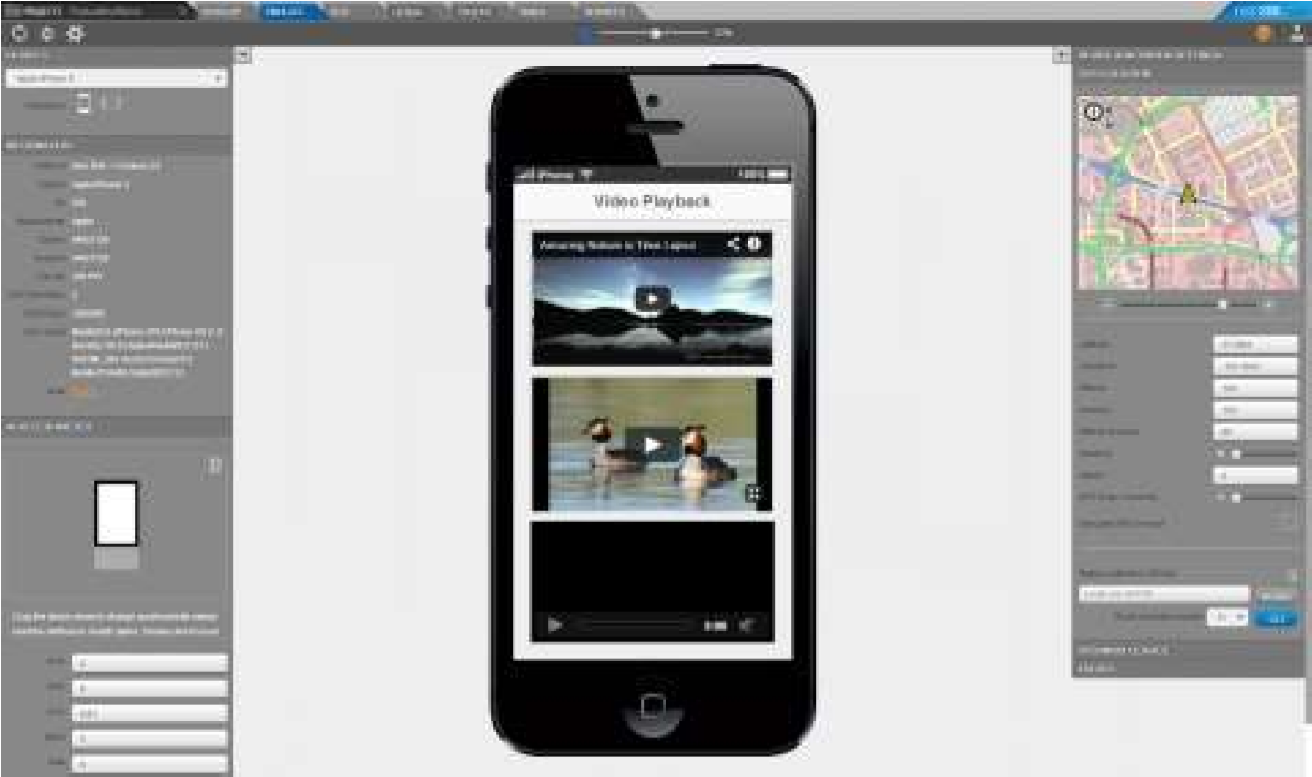
Integrated, simpler workflow, from idea to app store
For Inplant Training / Internship, please download the "Inplant training registration form" from our website www.kaashivinfotech.com. Fill the form and send it to kaashiv.info@gmail.com

Slide 7
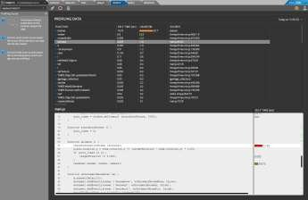
UI Builder to design app UI
framework for native platform access
*
b
Build and Publish to App Stores
For Inplant Training / Internship, please download the "Inplant training registration form" from our website www.kaashivinfotech.com. Fill the form and send it to kaashiv.info@gmail.com

Slide 8
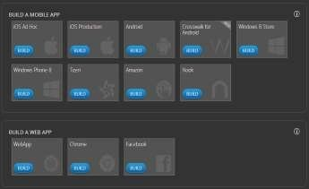
Deploy Simply Across Platforms, App Stores, and Form Factors
• Cloud-based build system simplifies packaging of Web and Hybrid built apps for various app stores
§ Publish to many app stores, across many form factors easily
Apple* App Store
Google* Play*
Windows* Store*
Tizen* App Store
Nook* Store (Android)
For Inplant Training / Internship, please download the "Inplant training registration form" from our website www.kaashivinfotech.com. Fill the form and send it to kaashiv.info@gmail.com

Slide 9




Contact Number
Venkat - 766 766 2428
Email – kaashiv.info@gmail.com
Priyanka - 72994 88034

Slide 10
Thank you
For Inplant Training / Internship, please download the "Inplant training registration form" from our website www.kaashivinfotech.com. Fill the form and send it to kaashiv.info@gmail.com

