Slide 1

KaaShiv InfoTech
Presents
INTEL XDK
For Inplant Training / Internship, please download the "Inplant training registration form" from our website www.kaashivinfotech.com. Fill the form and send it to kaashiv.info@gmail.com

Slide 2
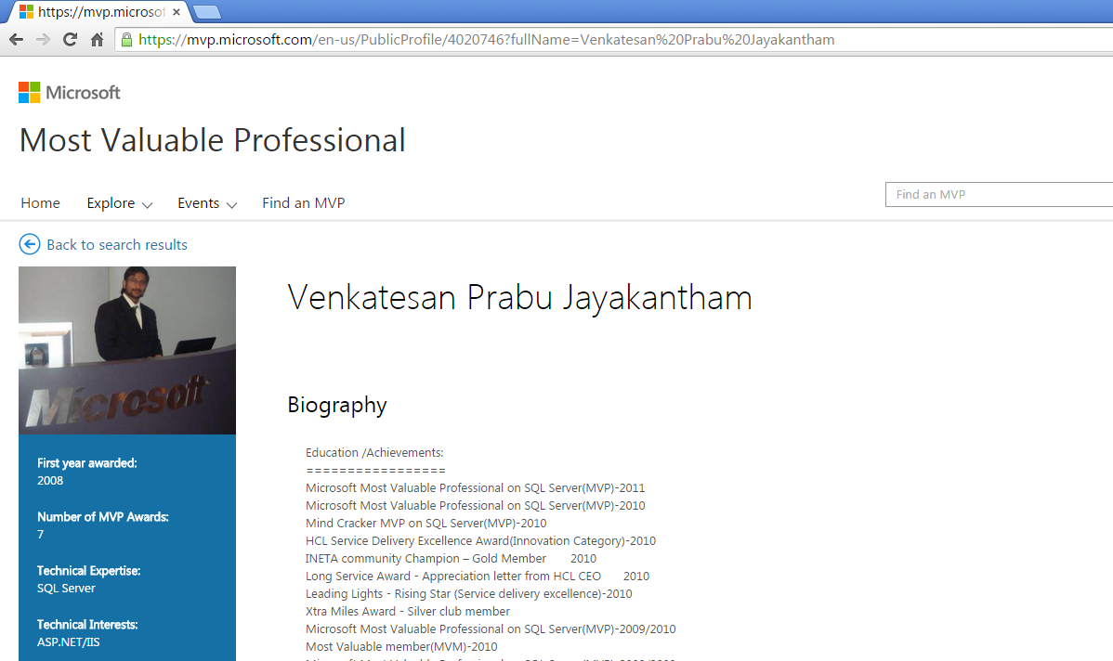
www.kaashivinfotech.com

Slide 3



Write once, Deploy Across Many App Stores and Devices
Intel®
XDK
All
-
in
-
one HTML5 Development Environment
Intel® XDK streamlined workflow enables developers to easily design, debug, build and deploy HTML5 web and hybrid apps across many app stores and form factors devices. Intel® XDK provides developers the tools, standards, and technology to reach more platforms, device coverage, and app stores cost effectively.
For Inplant Training / Internship, please download the "Inplant training registration form" from our website www.kaashivinfotech.com. Fill the form and send it to kaashiv.info@gmail.com

Slide 4
With Intel® XDK developers can easily build, test, and market a wide range of app genres, such as
Games, Entertainment, Business, Lifestyle, Education, Travel, Brain and Puzzle; Arcade and Action; Books and Reference; and Productivity apps.
For Inplant Training / Internship, please download the "Inplant training registration form" from our website www.kaashivinfotech.com. Fill the form and send it to kaashiv.info@gmail.com

Slide 5
Key Benefits
Maximizes development momentum from idea to deployment
Integrated templates, design, test, debug, and build tools to accelerate time-to-market
Quick deployment to Android*, iOS*, and Windows* app stores, across many devices, with one code base
For Inplant Training / Internship, please download the "Inplant training registration form" from our website www.kaashivinfotech.com. Fill the form and send it to kaashiv.info@gmail.com

Slide 6
Deliver amazing mobile Games, Entertainment, and Travel user app experiences across various devices.
Leverage the advantages of optimized JavaScript UI framework libraries, emulation tools, performance, and memory profiling tools to deliver immersive.
Responsive HTML5 app experiences across diverse devices.
For Inplant Training / Internship, please download the "Inplant training registration form" from our website www.kaashivinfotech.com. Fill the form and send it to kaashiv.info@gmail.com

Slide 7
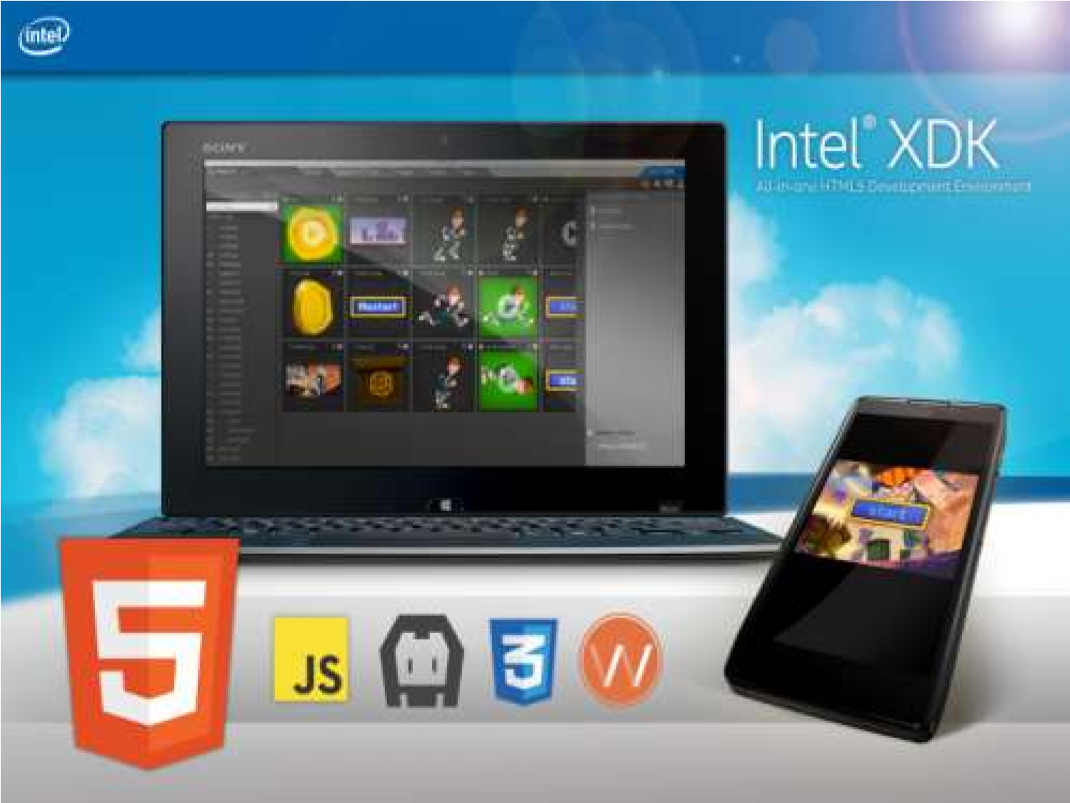
From Idea to App Store Streamlined Workflow
For Inplant Training / Internship, please download the "Inplant training registration form" from our website www.kaashivinfotech.com. Fill the form and send it to kaashiv.info@gmail.com

Slide 8
Intel® and ARM® Architecture
Intel® XDK Up-Close: Free download: XDK.Intel.com Intel® XDK IDE Built on Web technologies HTML, CSS, JavaScript*, and NodeWebkit backend Host support Microsoft Windows* 7-8.1, OS X*, and Ubuntu Linux* Target Store Support Android*, iOS*, Windows* 8, Amazon*, Nook*, Tizen*, Chrome*, Facebook*, Firefox* Marketplace
For Inplant Training / Internship, please download the "Inplant training registration form" from our website www.kaashivinfotech.com. Fill the form and send it to kaashiv.info@gmail.com

Slide 9
Design |  | Test & Debug |  | Publish
§ Quick start templates
UI Design & Editor Crosswalk RT for Android Game Tools, Services, & Asset Manager |  | Emulators & Debuggers Performance Profiler Live Development |  | Build & Package Services Popular Hybrid & Web stores
For Inplant Training / Internship, please download the "Inplant training registration form" from our website www.kaashivinfotech.com. Fill the form and send it to kaashiv.info@gmail.com

Slide 10
Game Tools and Services support | Easy path to Game Development, fast path to App Stores Construct2*, Cocos2D*, Phaser*, Pixi*, and EaselJS* part of CreateJS* Suite game engine support. Lets developers leverage Intel® XDK’s tools and free build services for Android*, iOS*, and Windows* app stores and devices • Game Asset Manager makes it easier to access, manage, and manipulate game assets with the Editor. Google* Play Game Services and Apple* Game Center services support. Enables game developers to drive engagements, reward players, socialize, set leaderboards, and achievements. W3C Gamepad API support for high-impact game interaction using gamepad or joystick devices.
For Inplant Training / Internship, please download the "Inplant training registration form" from our website www.kaashivinfotech.com. Fill the form and send it to kaashiv.info@gmail.com

Slide 11
APIs and plug-ins | Everything in one place to easily manage APIs and Plug-ins Intel® XDK plug-in for Sublime* Text – provides direct access to Intel XDK tools from the Sublime Text Toolbar menu Cordova* 4.x base container for all OS platforms, plus100’s of Cordova APIs Cordova* 4,x, PhoneGap*, and Github* repository 3rd party plug-in support Monetization, advertising, maps, Facebook, DataStream services, Secure data and Secure storage APIs, Dolby API
For Inplant Training / Internship, please download the "Inplant training registration form" from our website www.kaashivinfotech.com. Fill the form and send it to kaashiv.info@gmail.com

Slide 12
Emulate, Test, Debug | Saves time with easy and fast app testing & debugging Real-time live testing & editing on device side-by-side app preview Emulator - test on-board device sensors, push messages, firing events JS Remote Debugger for Android* and iOS* - Efficiently debug apps remotely
For Inplant Training / Internship, please download the "Inplant training registration form" from our website www.kaashivinfotech.com. Fill the form and send it to kaashiv.info@gmail.com

Slide 13
Expanded Device API Support | More native access to device features, better mobile user experiences Cordova* 4.X API apps device emulator, testing support for many devices Access device and native platform features through JavaScript* APIs Crosswalk Runtime for Android extends Hybrid app capabilities
For Inplant Training / Internship, please download the "Inplant training registration form" from our website www.kaashivinfotech.com. Fill the form and send it to kaashiv.info@gmail.com

Slide 14
Standards, OS support, Pricing | Business value, one codebase for multiple OSs, App Store, & devices Open Standards – HTML5, CSS3, JavaScript makes everything much easier Supported on Windows 7 & 8, Apple OS X, and Ubuntu Linux Pricing: Free download at: http://XDK.Intel.com
For Inplant Training / Internship, please download the "Inplant training registration form" from our website www.kaashivinfotech.com. Fill the form and send it to kaashiv.info@gmail.com

Slide 15




Contact Number
Venkat - 766 766 2428
Email – kaashiv.info@gmail.com
Priyanka - 72994 88034

Slide 16
Thank you
For Inplant Training / Internship, please download the "Inplant training registration form" from our website www.kaashivinfotech.com. Fill the form and send it to kaashiv.info@gmail.com

